Slide 1

Energy Storage Devices

Slide 2
Objective of Lecture
Describe
  The construction of an inductor
  How energy is stored in an inductor
  The electrical properties of an inductor
    Relationship between voltage, current, and inductance; power; and energy
  Equivalent inductance when a set of inductors are in series and in parallel

Slide 3
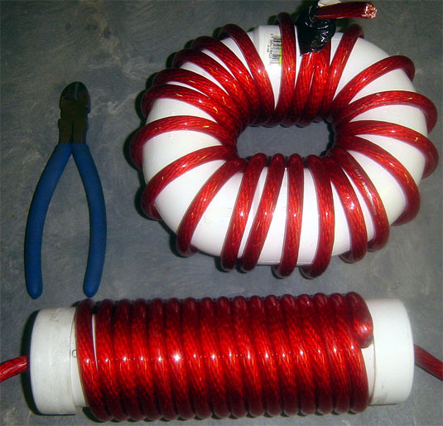
Inductors
Generally - coil of conducting wire
  Usually wrapped around a solid core. If no core is used, then the inductor is said to have an ‘air core’.
http://bzupages.com/f231/energy-stored-inductor-uzma-noreen-group6-part2-1464/

Slide 4
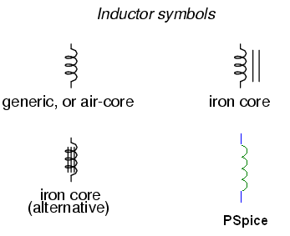

Symbols
http://www.allaboutcircuits.com/vol_1/chpt_15/1.html

Slide 5
Alternative Names for Inductors
Reactor- inductor in a power grid
Choke - designed to block a particular frequency while allowing currents at lower frequencies or d.c. currents through
  Commonly used in RF (radio frequency) circuitry
Coil - often coated with varnish and/or wrapped with insulating tape to provide additional insulation and secure them in place
  A winding is a coil with taps (terminals).
Solenoid – a three dimensional coil.
  Also used to denote an electromagnet where the magnetic field is generated by current flowing through a toroidal inductor.

Slide 6
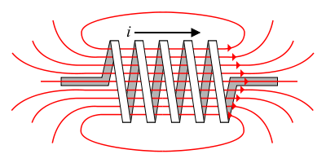
Energy Storage
The flow of current through an inductor creates a magnetic field (right hand rule).
If the current flowing through the inductor drops, the magnetic field will also decrease and energy is released through the generation of a current.
B field
http://en.wikibooks.org/wiki/Circuit_Theory/Mutual_Inductance

Slide 7
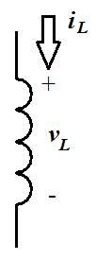
Sign Convention
The sign convention used with an inductor is the same as for a power dissipating device.
  When current flows into the positive side of the voltage across the inductor, it is positive and the inductor is dissipating power.
  When the inductor releases energy back into the circuit, the sign of the current will be negative.

Slide 8
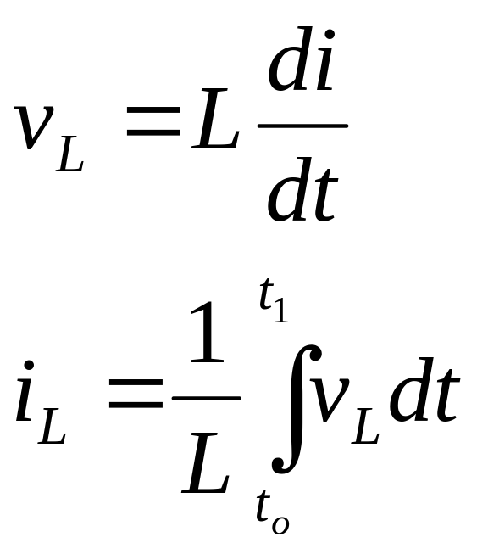
Current and Voltage Relationships
L , inductance, has the units of Henries (H)
1 H = 1 V-s/A

Slide 9
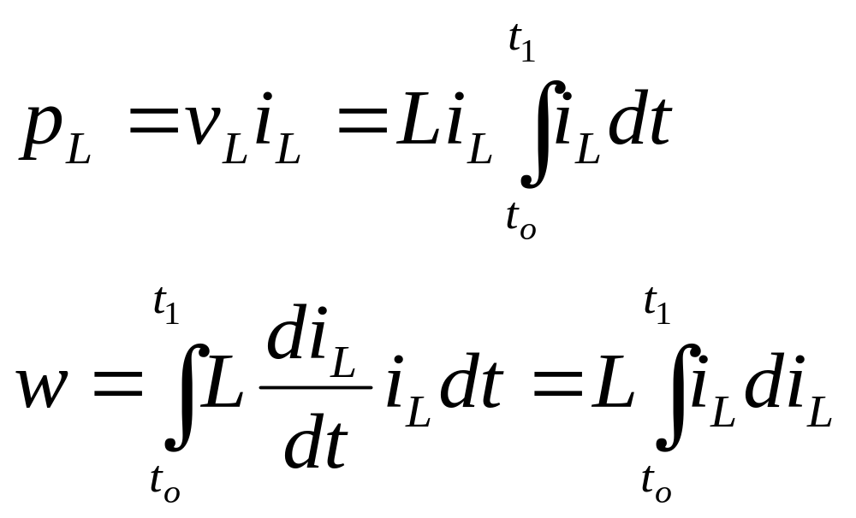
Power and Energy

Slide 10
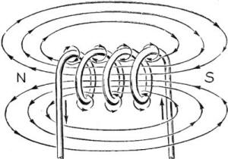
Inductors
Stores energy in an magnetic field created by the electric current flowing through it.
  Inductor opposes change in current flowing through it.
    Current through an inductor is continuous; voltage can be discontinuous.
http://www.rfcafe.com/references/electrical/Electricity%20-%20Basic%20Navy%20Training%20Courses/electricity%20-%20basic%20navy%20training%20courses%20-%20chapter%2012.htm

Slide 11
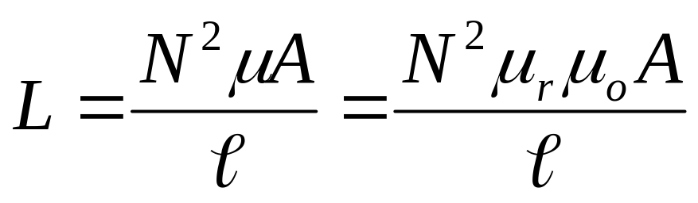
Calculations of L
For a solenoid (toroidal inductor)
N is the number of turns of wire
A is the cross-sectional area of the toroid in m².
μ_{r} is the relative permeability of the core material
μ_{o} is the vacuum permeability (4π × 10⁻⁷ H/m)
l is the length of the wire used to wrap the toroid in meters

Slide 12
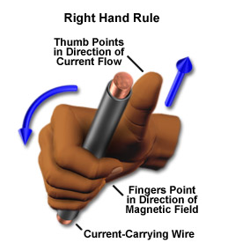
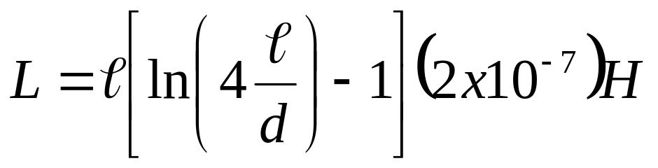
Wire
Unfortunately, even bare wire has inductance.
d is the diameter of the wire in meters.

Slide 13
Properties of an Inductor
Acts like an short circuit at steady state when connected to a d.c. voltage or current source.
Current through an inductor must be continuous
  There are no abrupt changes to the current, but there can be abrupt changes in the voltage across an inductor.
An ideal inductor does not dissipate energy, it takes power from the circuit when storing energy and returns it when discharging.

Slide 14
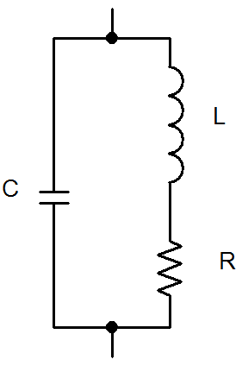
Properties of a Real Inductor
Real inductors do dissipate energy due resistive losses in the length of wire and capacitive coupling between turns of the wire.

Slide 15
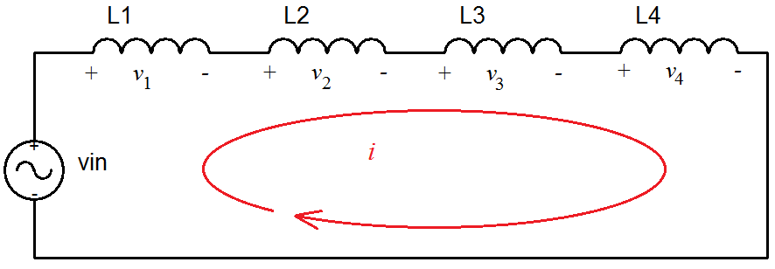
Inductors in Series

Slide 16
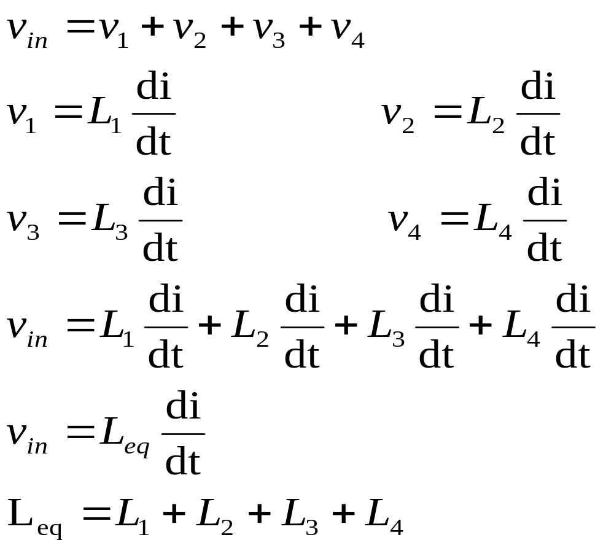
L_{eq} for Inductors in Series

Slide 17
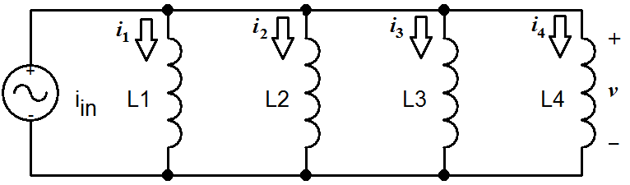
Inductors in Parallel

Slide 18
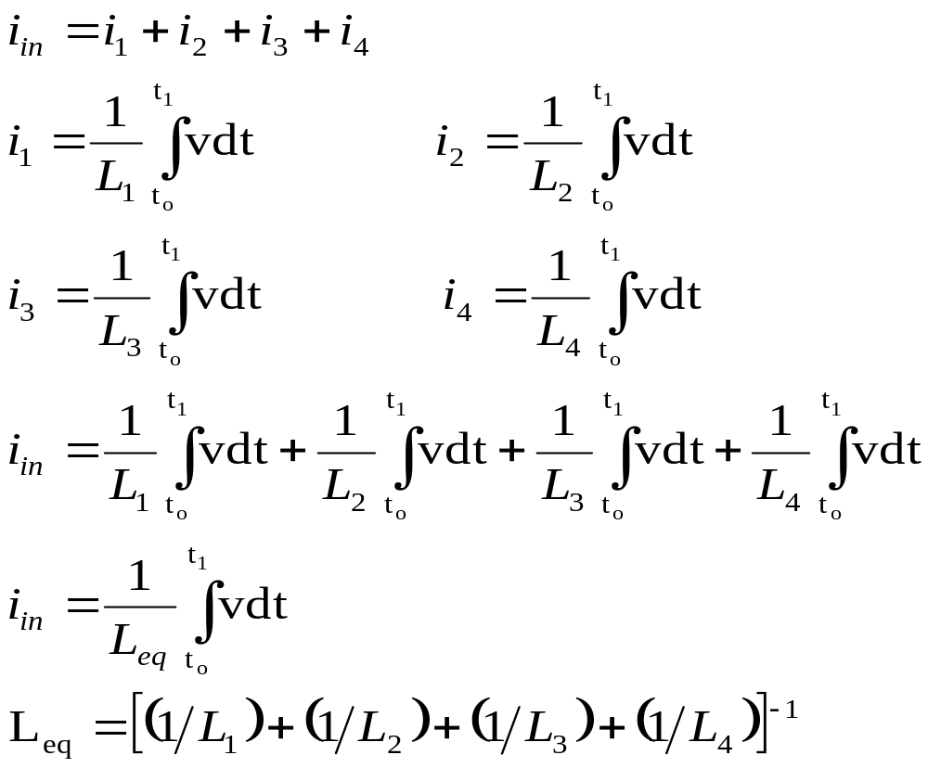
L_{eq} for Inductors in Parallel

Slide 19
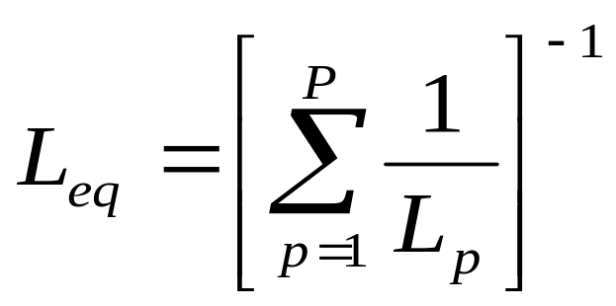
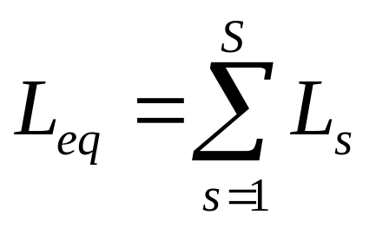
General Equations for L_{eq}
Series Combination
Parallel Combination
If S inductors are in series, then
If P inductors are in parallel, then:

Slide 20


Summary
Inductors are energy storage devices.
An ideal inductor act like a short circuit at steady state when a DC voltage or current has been applied.
The current through an inductor must be a continuous function; the voltage across an inductor can be discontinuous.
The equation for equivalent inductance for
  inductors in series inductors in parallel

